Slide 1
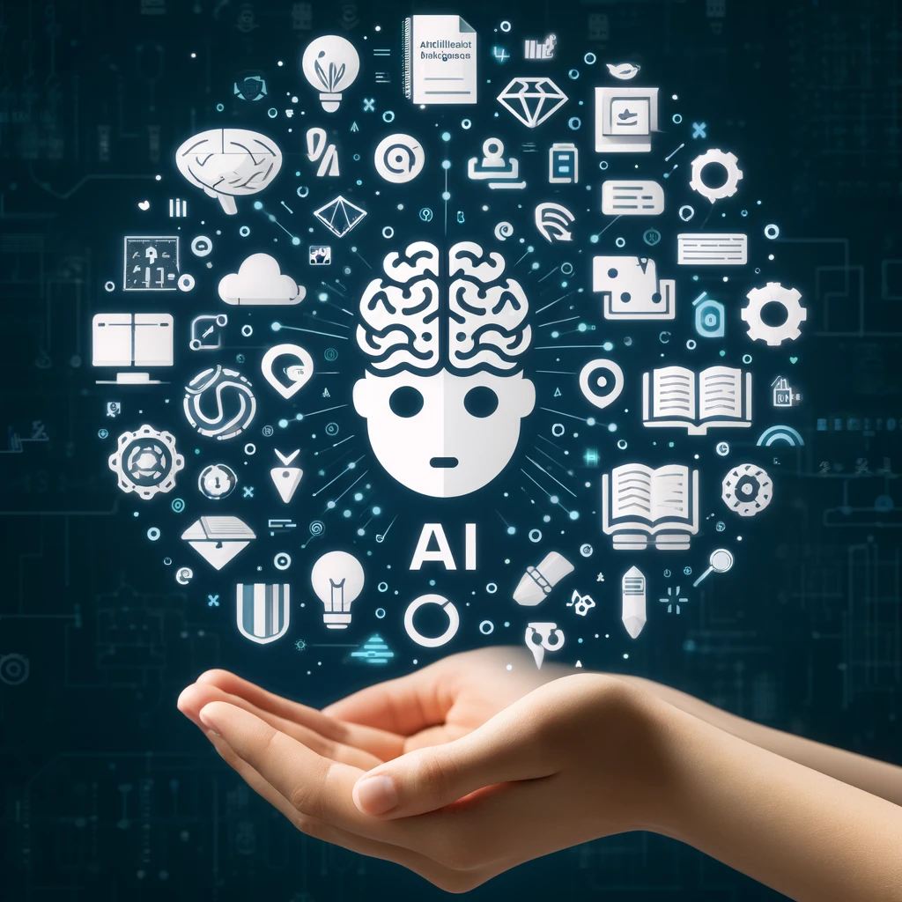
AI in Textual Content Creation

Slide 2
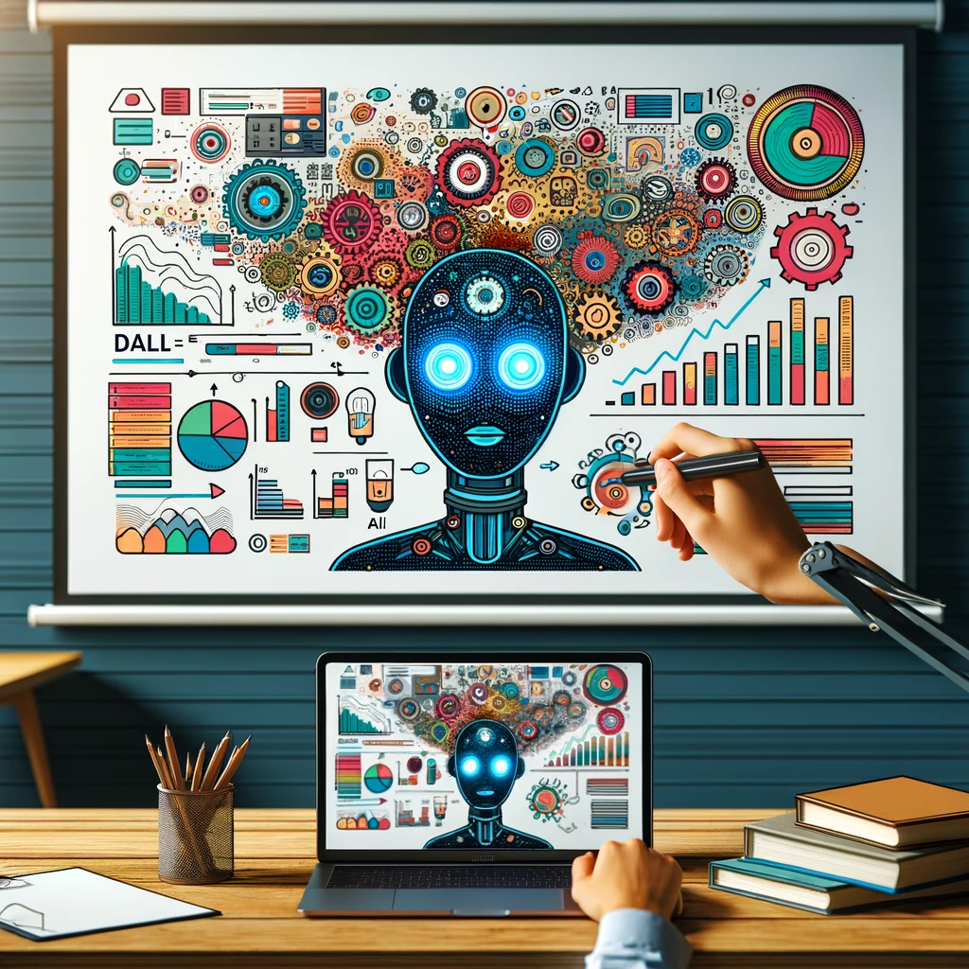
Visual Content with AI

Slide 3
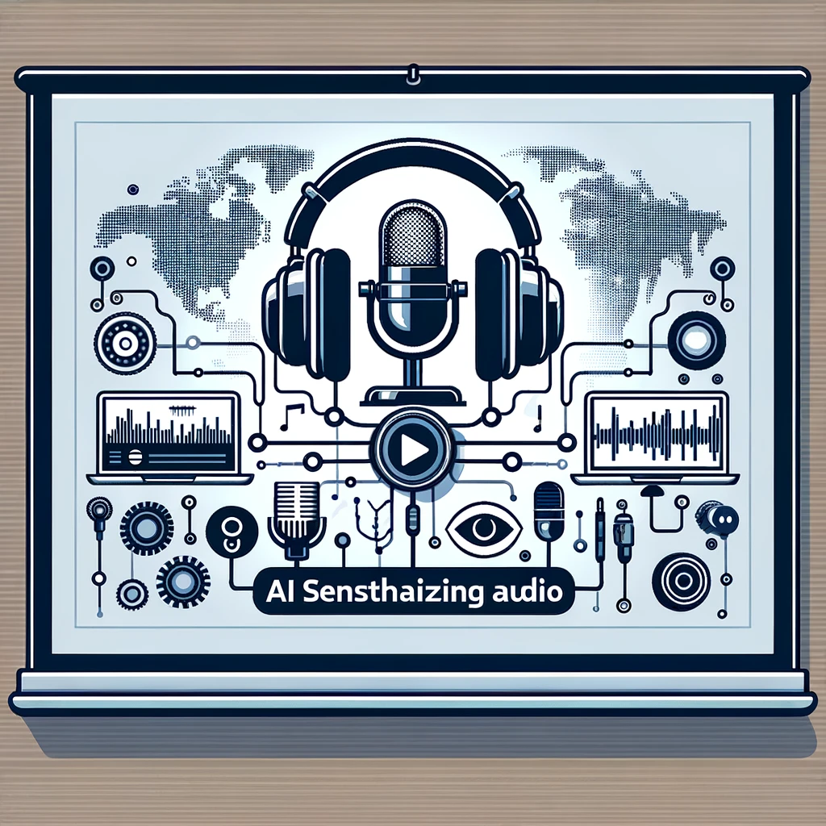
AI-Synthesized Audio for Education

Slide 4
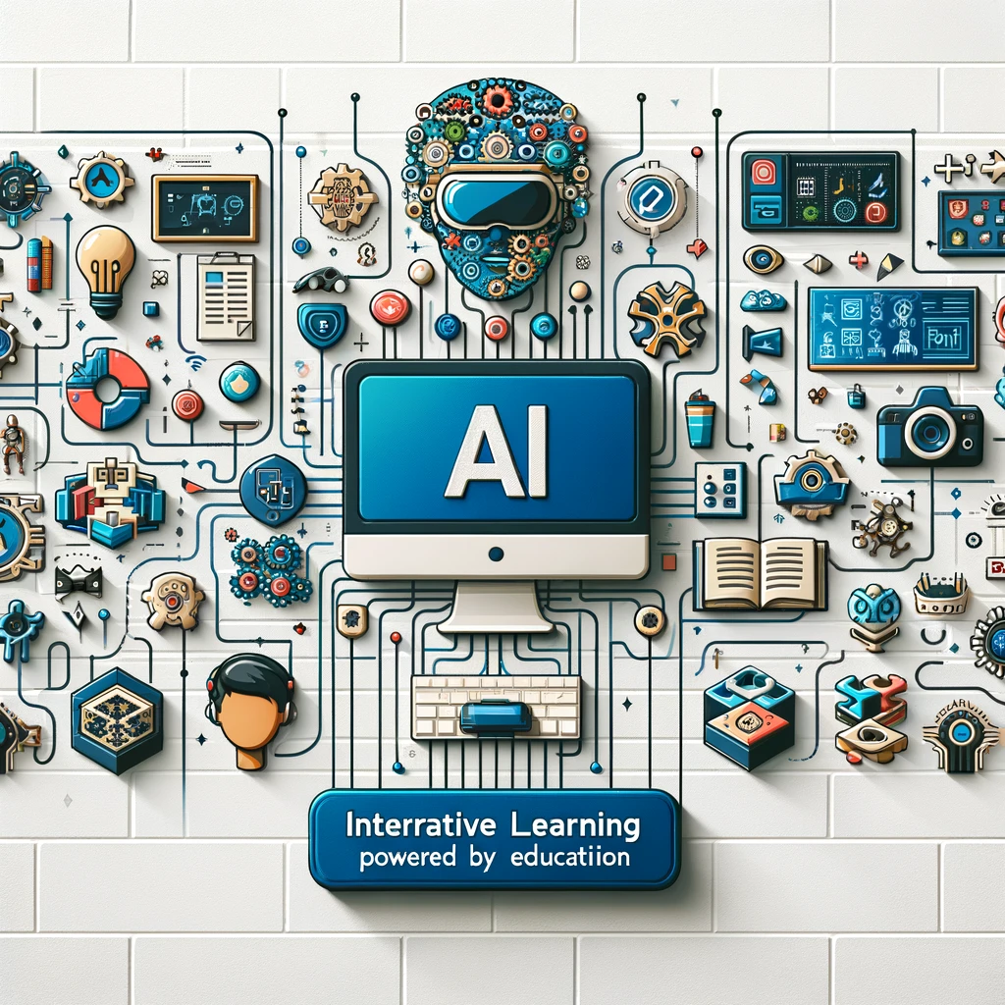
Interactive Learning with AI

Slide 5
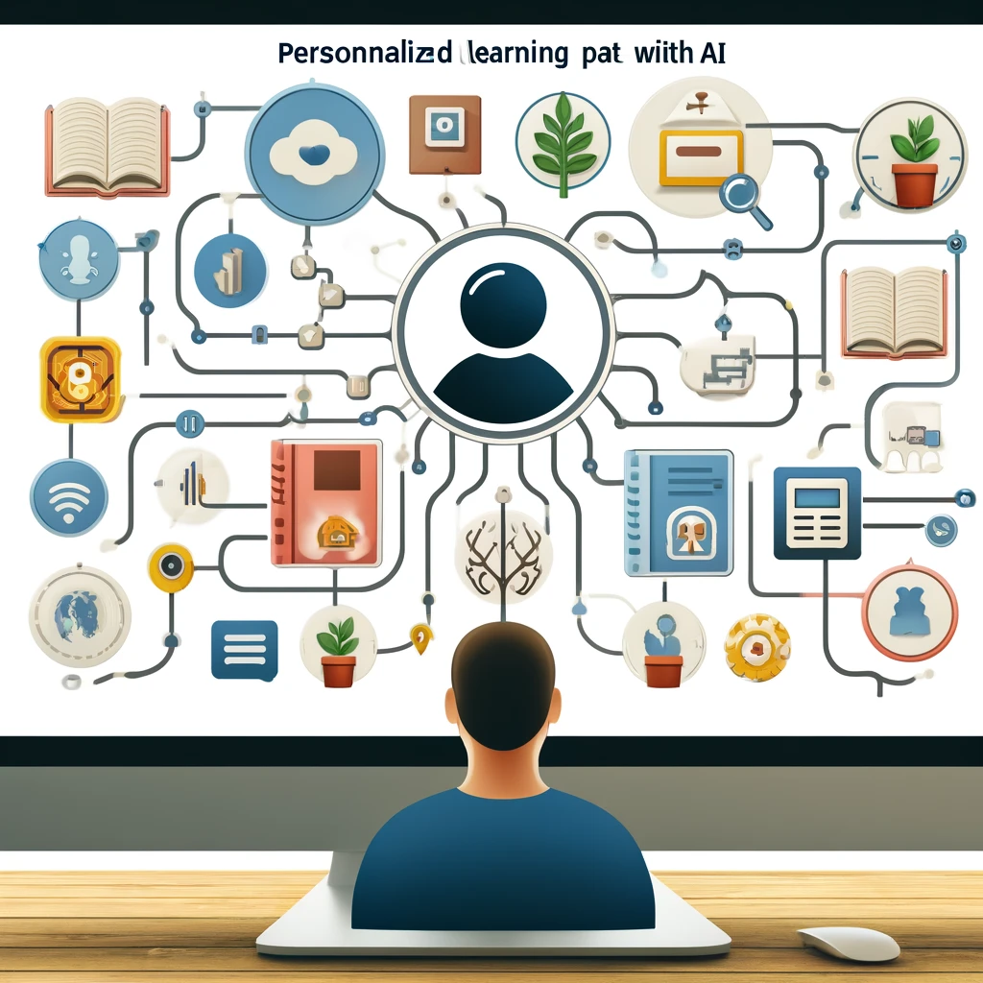
Personalized Learning Experiences

